Slide 1
Types of Algorithms

Slide 2
Basic Steps of the complete development of an algorithm

Slide 3
1- Statement of the problem
2-Development of a model
3-Design of an algorithm
4-Correctness of the algorithm
5-Implementation
6-Analysis and complexity of the algorithm
7-Program testing
8-documentation

Slide 4
Statement of the problem
1 Do I understand the vocabulary used in the raw formulation?
What information has been given?
What do I want to find out?
How do I recognize a solution?
What information is missing.and will any of this be of use?
Is any of the given information worthless?
What assumptions have been made?

Slide 5
Development of a model
Which mathematical structures seem best-suited for the problem?
Are there any other problems that have been solved which resemble this one?

Slide 6
Documentation
Golden rule:
Document your program the way you want others to document the program which you read

Slide 7
(divide and conquer)
this technique divides a given problem into smaller instances of the same problem, Solves the smaller problems and combine solutions to solve the given problem.
(b) Greedy algorithm: An algorithm which always takes the best immediate or local solution while finding the answer. Greedy algorithms will find the over all or globally optimal solution for some optimization problems but may find less than optimal (suboptimal solutions) for some. These algorithms are very easy to design.

Slide 8
( c ) Dynamic programming Algorithm: It solves sub problems just once and save the solutions in a table. The solution will be retrieve when the same problem is encountered later on.
Back tracking algorithm: An algorithmic technique by trying one of the several possible choices. If the choice proves incorrect, computation backtracks or restarts at the point of choice and tries another choice.
Branch and bound: it is similar to backtracking.In backtracking we try to find one or all configurations modeled as n- tuples which satisfy certain properties.Branch and bound algorithms are oriented more toward optimization. Here a bounding function is developed to prove incorrect choice.

Slide 9
Approximate algorithm: An algorithm to solve an optimization problem that runs in polynomial time in the length of input and outputs the a solution that is guaranteed to be close to the optimal solution.
Randomized algorithm :An algorithm is randomized if some of the decisions depend upon the output of a randomizer. A randomized algorithm is said to be Las Vegas algorithm If it always produce the same correct output for the same input. If the output differs from run to run for the same input we call it Monte Carlo algorithm.

Slide 10
(h) Genetic Algorithm: It is an effective method for optimization problems.It was introduced by J.H.Holland in 1975..It manipulates bit strings analogously to DNA evolution. Here we represent a possible solution as a chromosome. This technique creates a population of chromosome and applies genetic operators such as mutation and crossover to evolve the solutions in order to find the best.

Slide 11
(i) Parallel algorithm: A parallel algorithm is an algorithm that has been specially written for execution on a computer with two or more processors.

Slide 12
Divide and Conquer algorithms

Slide 13
Motivation
Given a large data set
(DIVIDE): Partition the data set into smaller sets
Solve the problems for the smaller sets
(CONQUER): Combine the results of the smaller sets

Slide 14
Merge Sort
Sort: 10, 4, 20, 8, 15, 2, 1, -5
DIVIDE:
DIVIDE:
Sort
(Conquer)‏
COMBINE:
COMBINE:
Brute Force: n², Merge Sort: n log n
10 4 20 8
15 2 1 -5
10 4
20 8
15 2
1 -5
4 10
8 20
2 15
-5 1
4 8 10 20
-5 1 2 15
-5 1 2 4 8 10 15 20

Slide 15
What did we do?
We are breaking down a larger problem into smaller sets (DIVIDE).
After solving the smaller set problems (CONQUER), we combine the answers.

Slide 16
General Template
Divide_and_Conquer (x)‏
  if x is small or simple
  return solve(x)‏
  else
  Decompose x into smaller sets x₀, x₁, … x_{n}
  for (i=0; i<n; i++)‏
  y_{i} = Divide_and_Conquer(x_{i})‏
  Recombine y_{i}’s. (We have solved y for x)‏
  return y

Slide 17
Three Conditions that make D&C worthwhile
It must be possible to decompose an instance into sub-instances.
2. It must be efficient to recombine the results.
3. Sub-instances should be about the same size.

Slide 18
MERGE SORT
The procedure merge sort sorts the elements in the sub array A[low,high].
If low≥high the sub array has at most one element and is therefore already sorted.
Otherwise we divide it into A[low,mid] and array[mid+1..high]

Slide 19
Merge sort(A,low,high)‏
if low <high
then mid←[(low+high)/2]
merge sort(A, low, mid)‏
merge sort(A, mid+1, high)‏
merge (low, mid, high)‏

Slide 20
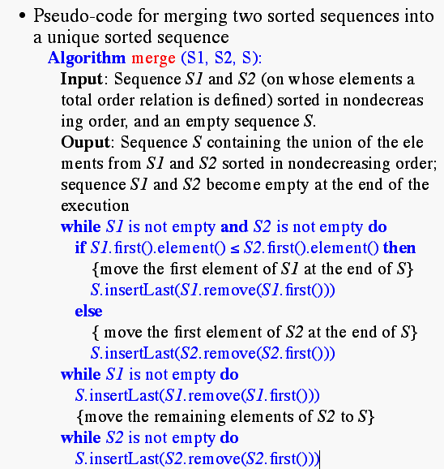
Merging Two Sequences

Slide 21
Algorithm Merge (low,mid,high)‏
{ h:= low; i:=low; j:=mid+1;
while((h ≤ mid) and (j ≤ high)) do
{
if (a[h] ≤ a[j] then
{
b[I]:= a[h]; h:=h+1;
}
Else
{b[I]:=a[j];j:=j+1;
}
I:=I+1;
}

Slide 22
If(h> mid) then
for k:=j to high do
{
B[I]:=a[k];I:=I+1;
}
Else
for k:= h to mid do
{
B[I] :=a[k]; I:= I+1;
}
For k:= low to high do a[k]:= b[k];
}
Time for merging is proportional to n.

Slide 23
Merge-Sort
Algorithm:
  Divide: If S has at leas two elements (nothing needs to be done if S has zero or one elements), remove all the elements from S and put them into two sequences, S₁ and S₂, each containing about half of the elements of S. (i.e. S₁ contains the first ⎡n/2⎤ elements and S₂ contains the remaining ⎣n/2⎦ elements.
  Recur: Recursive sort sequences S₁ and S₂.
  Conquer: Put back the elements into S by merging the sorted sequences S₁ and S₂ into a unique sorted sequence.

Slide 24
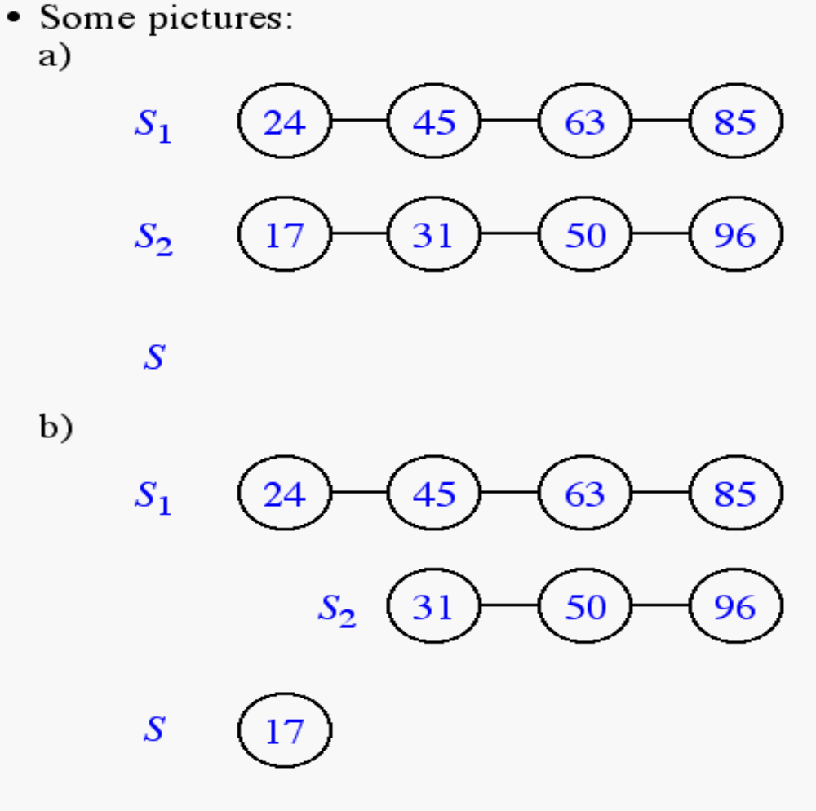
Merging Two Sequences (cont.)‏

Slide 25
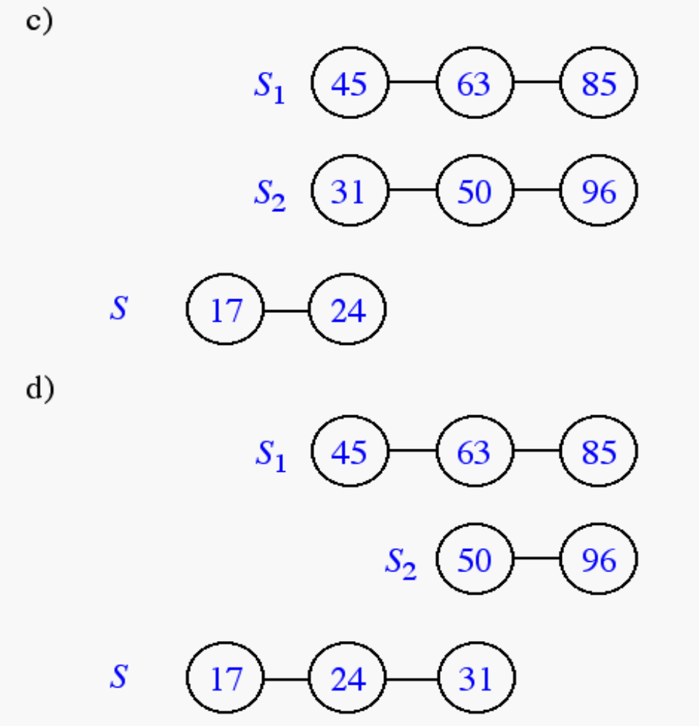
Merging Two Sequences (cont.)‏

Slide 26
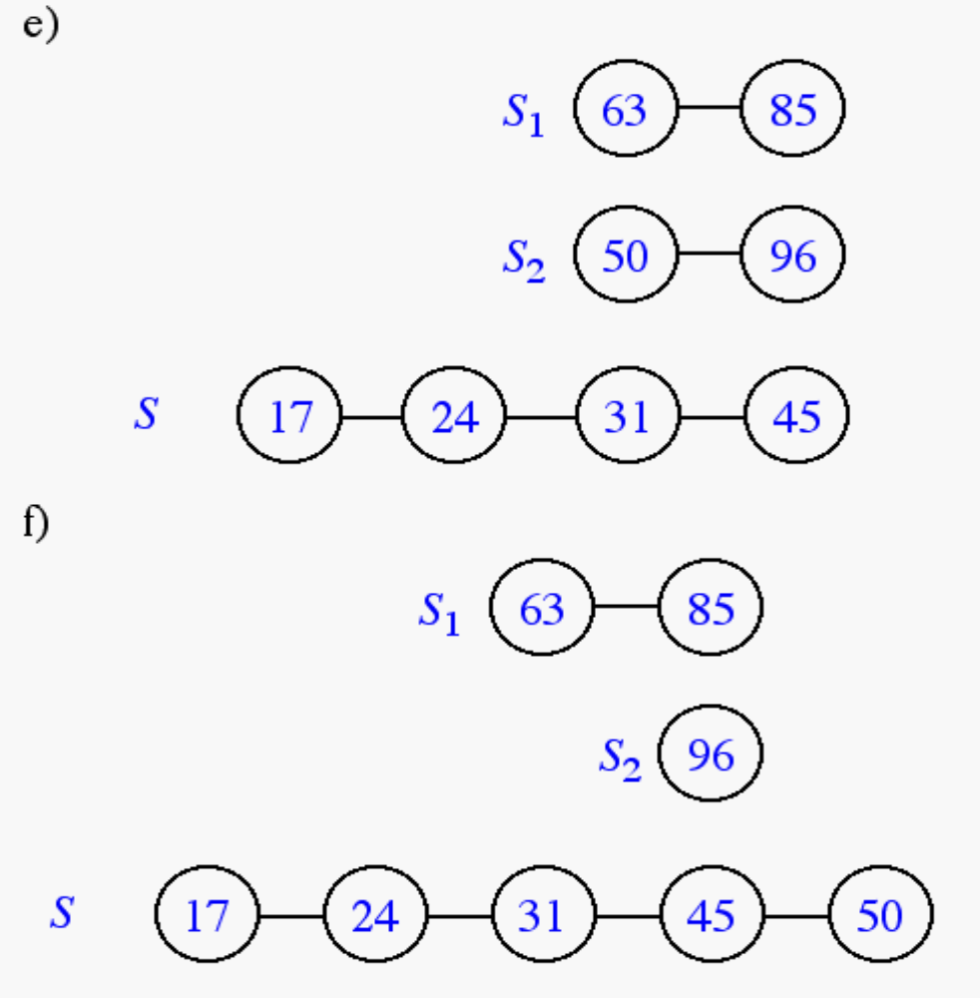
Merging Two Sequences (cont.)‏

Slide 27
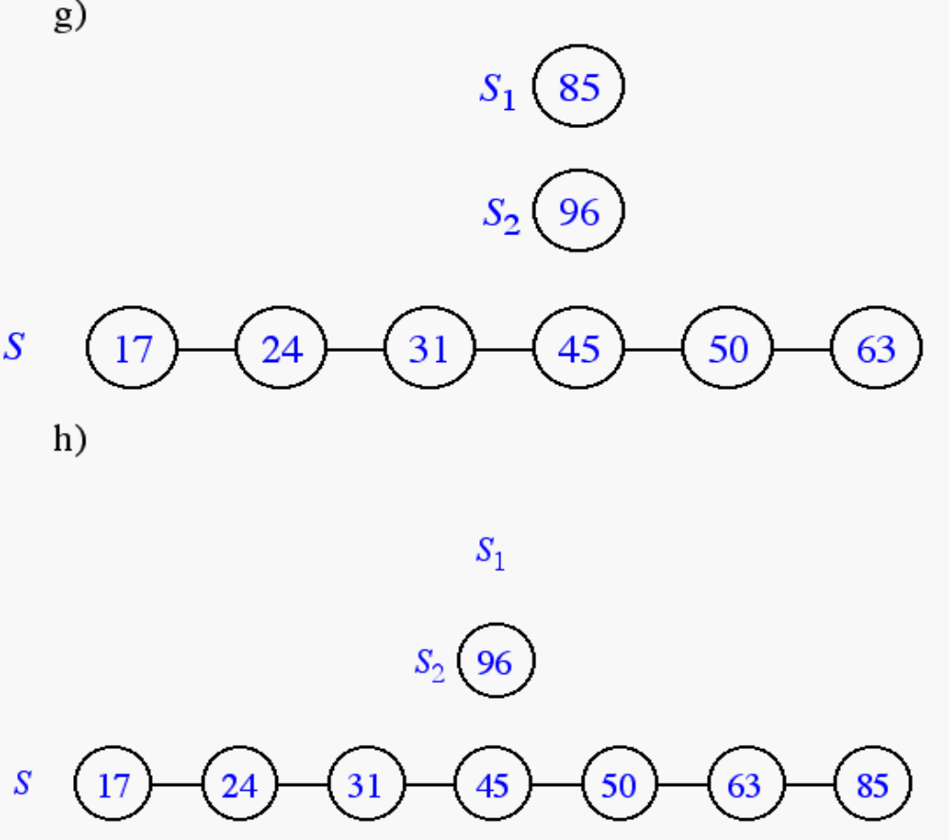
Merging Two Sequences (cont.)‏

Slide 28
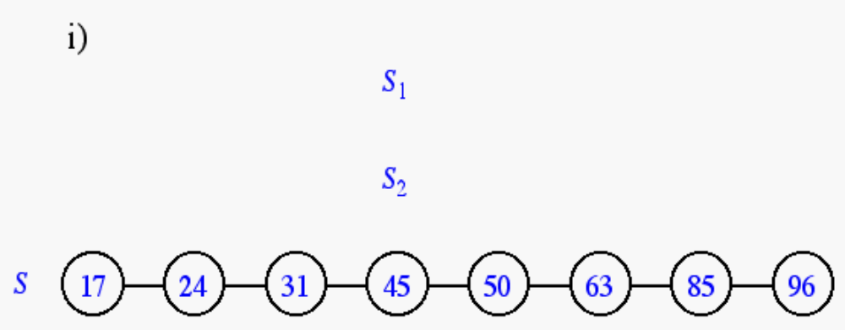
Merging Two Sequences (cont.)‏

Slide 29
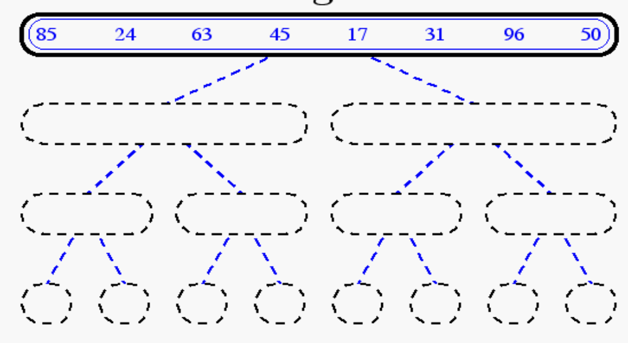
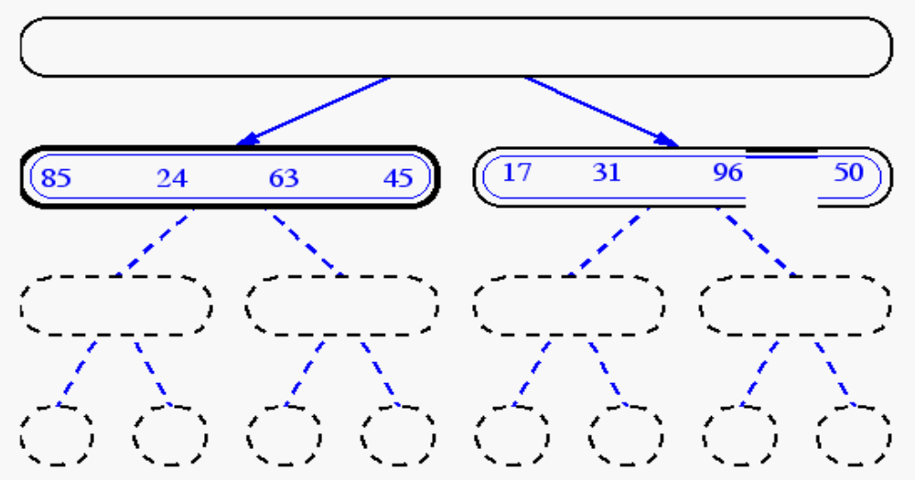
Merge-Sort

Slide 30
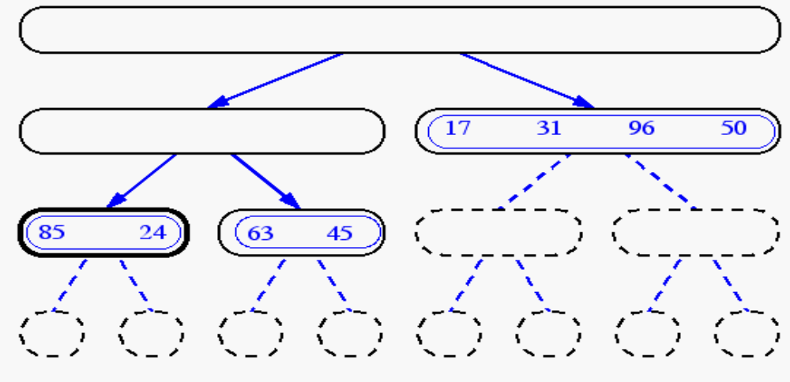
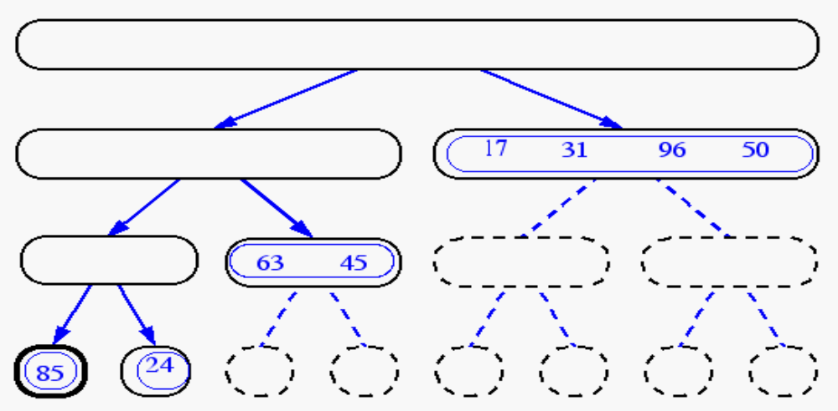
Merge-Sort(cont.)‏

Slide 31
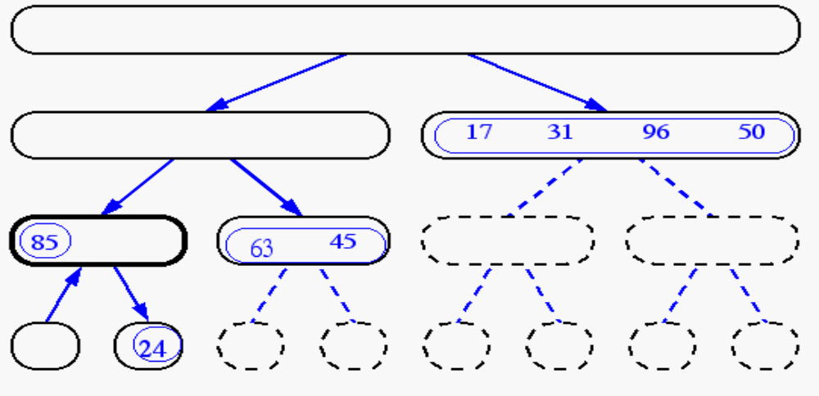
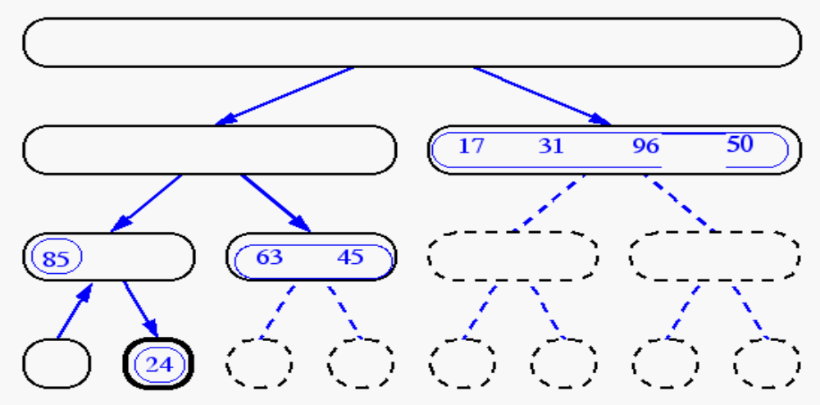
Merge-Sort (cont.)‏

Slide 32
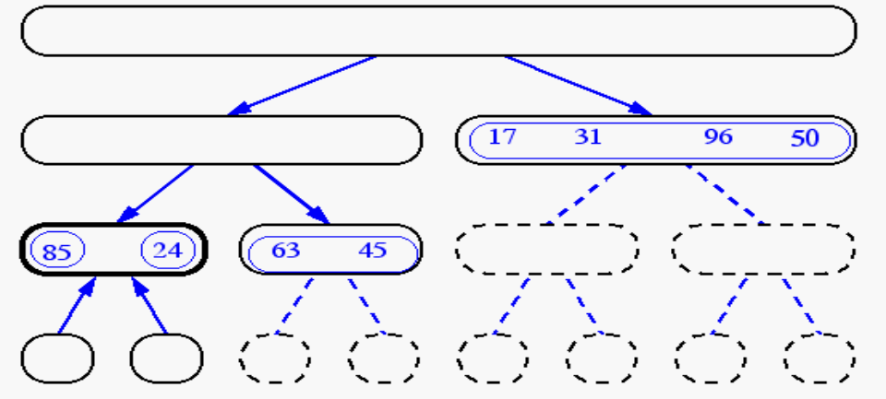
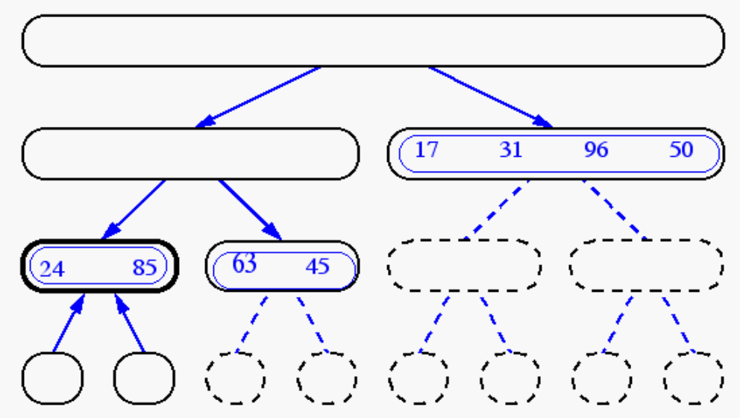
Merge-Sort (cont.)‏

Slide 33
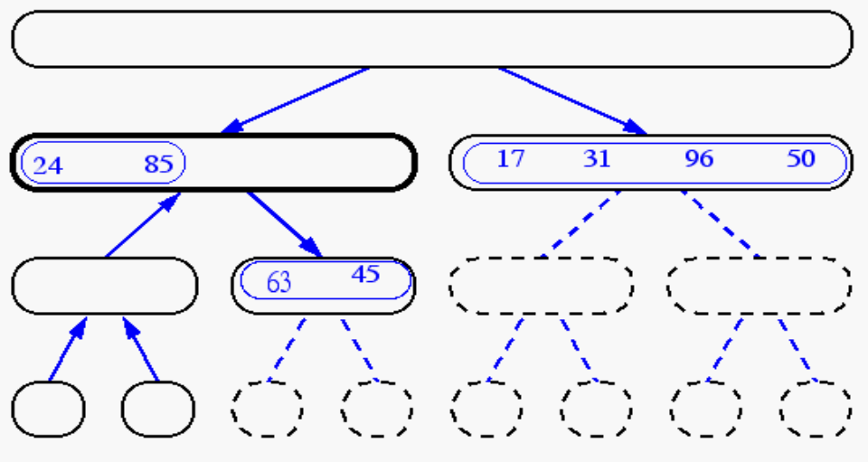
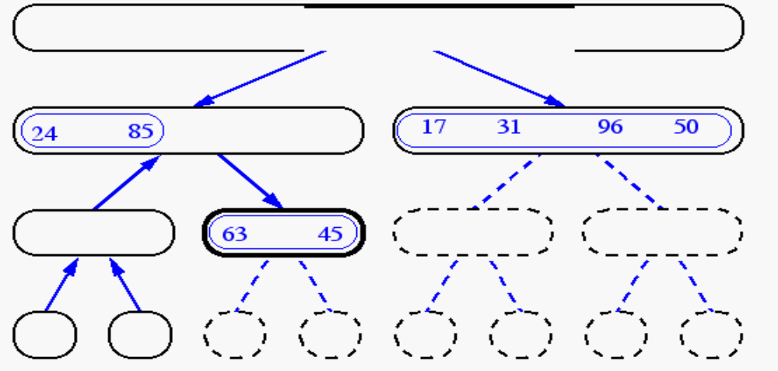
Merge-Sort (cont.)‏

Slide 34
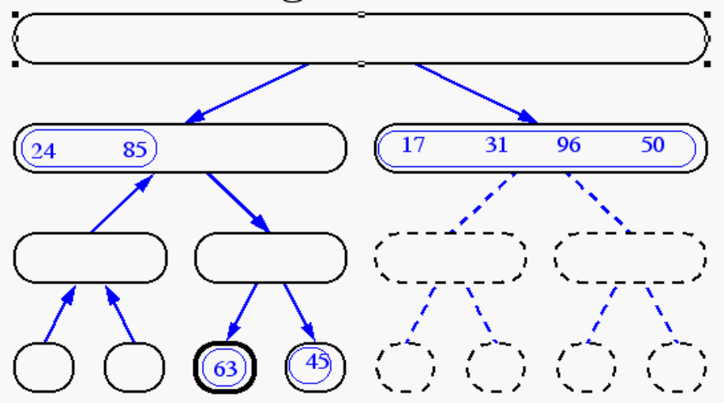
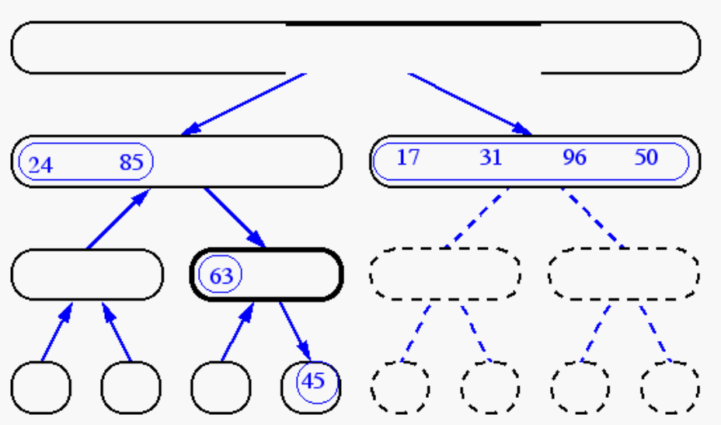
Merge-Sort (cont.)‏

Slide 35
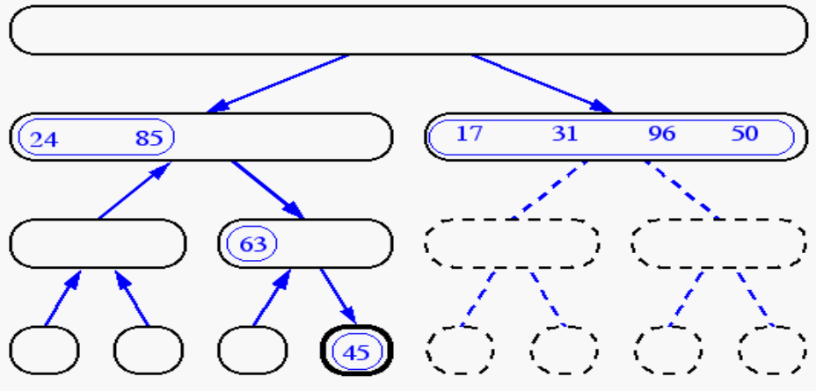
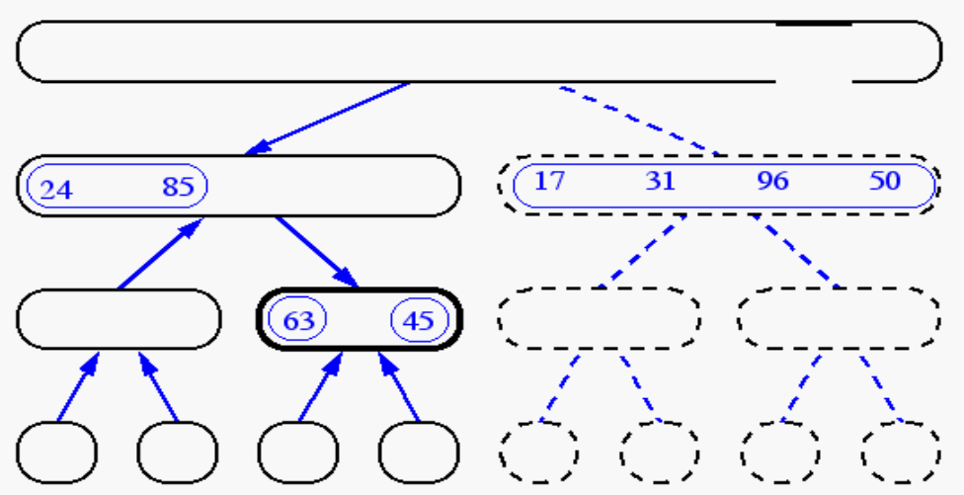
Merge-Sort (cont.)‏

Slide 36
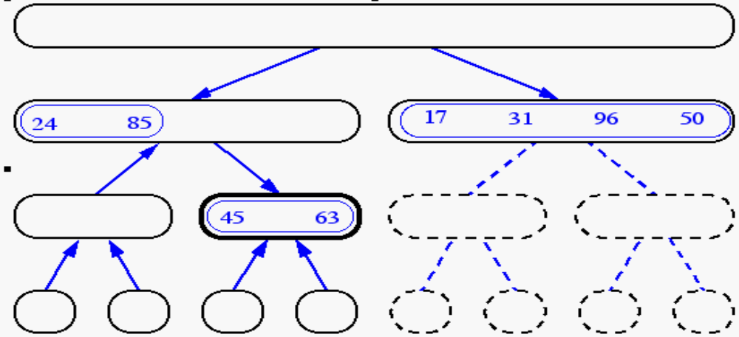
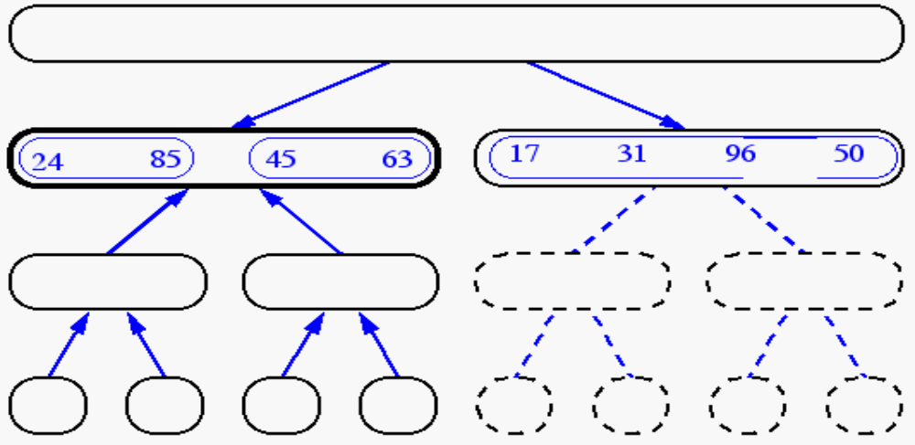
Merge-Sort(cont.)‏

Slide 37
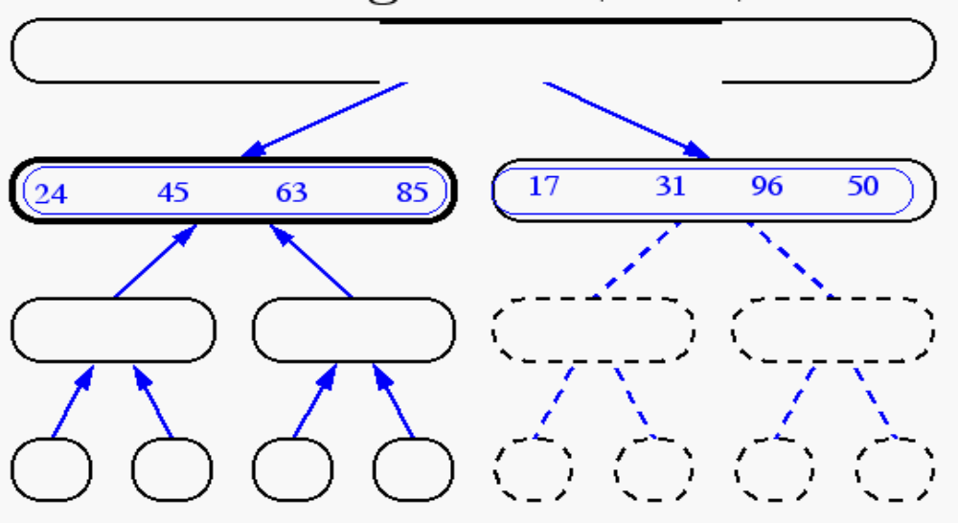
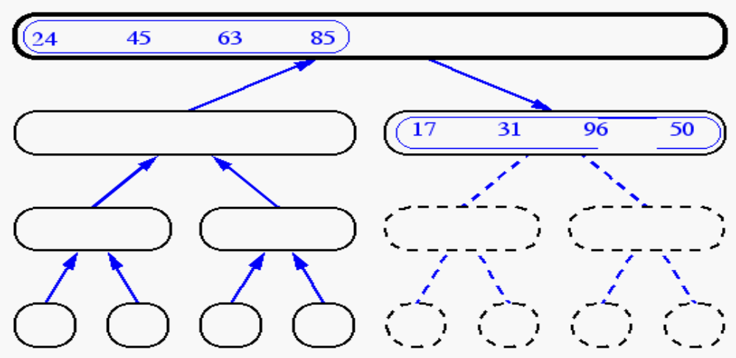
Merge-Sort (cont.)‏

Slide 38
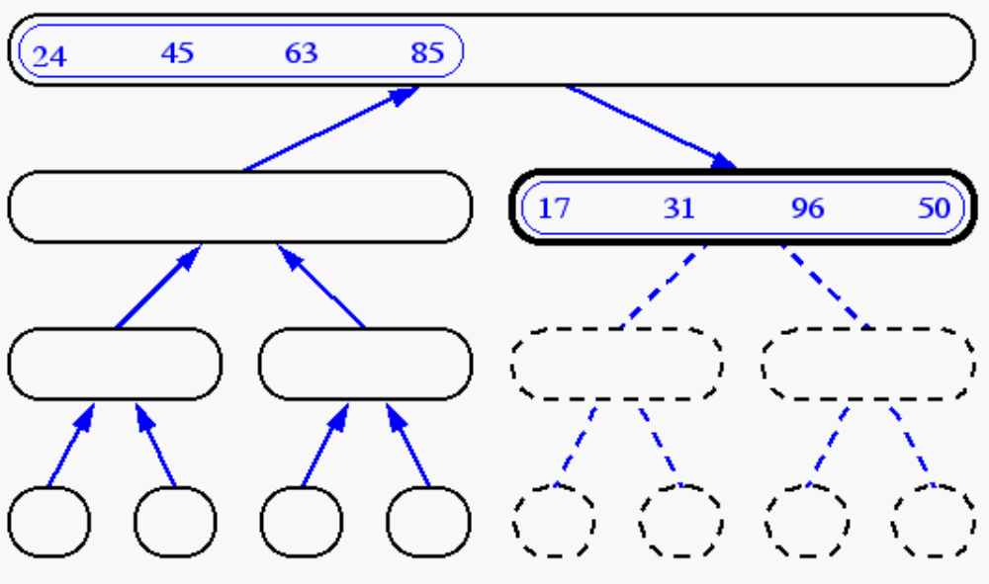
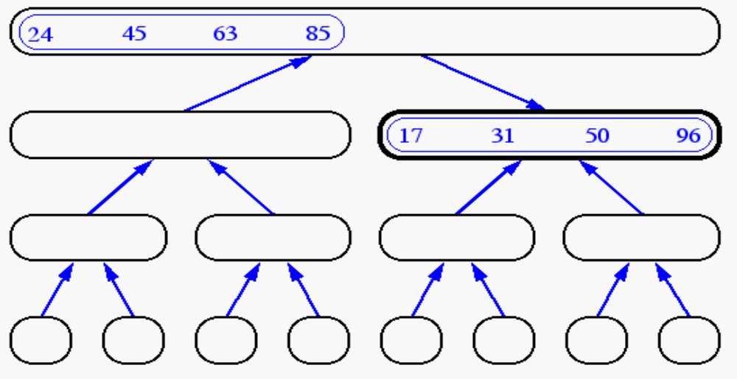
Merge-Sort (cont.)‏

Slide 39
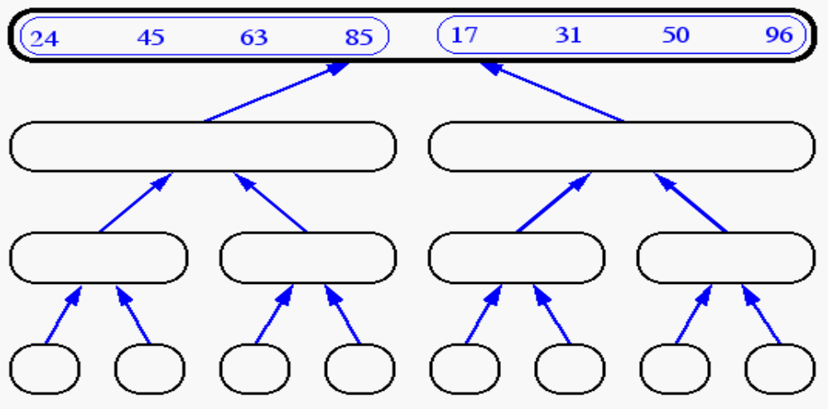
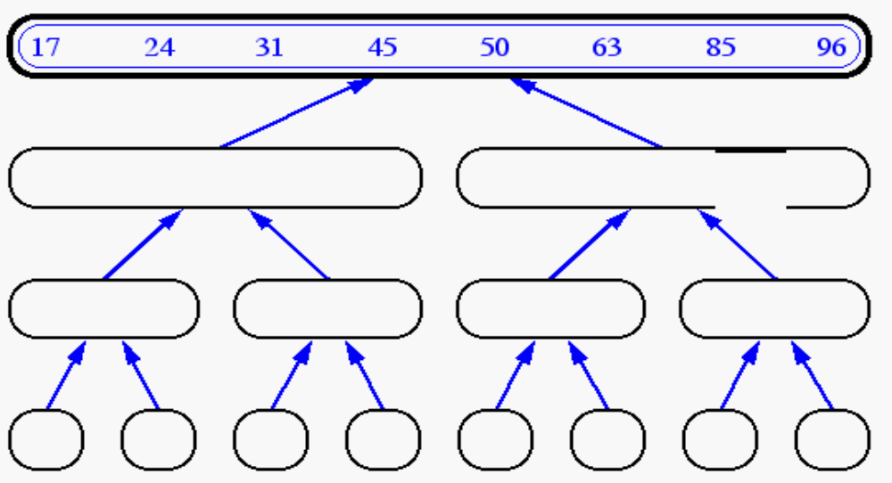
Merge-Sort (cont.)‏

Slide 40
Binary search
Given a sorted array T and an item x.
We want to find out the index location of x in T.
If x does not exist in T, we want the index location of where it would be inserted.
Find i, such that T[i-1] < x < T[i]

Slide 41
Binary Search
Search: (6, 12, 18, 20, 27, 34, 35)‏
Brute Force:
  Best Case: O(1)‏
  Worst Case: O(n)‏
  Average Case: O(n/2) = O(n)‏
Binary Search Tree:
  Best Case: O(1)‏
  Worst Case: O(log n)‏
  Average Case: O(~log n - 1) = O(log n)‏
20
12
34
6
18
27
35

Slide 42
What are some examples similar to Binary Search?
How do you look up a name in the phone book?
How do you look up a word in the dictionary?
How can we make it more efficient?
  Look up something based on the first letter
  What is this analogous to in the divide and conquer scheme?

Slide 43
Analyzing divide and conquer algorithms
Total time of an algorithm based on divide and conquer approach is based on three timings:
Let T(n) be the running time on a problem of size n. If the problem size is small straight forward solution takes constant time say θ(1).
Suppose we divide the problem into a number of sub problems each of size 1/b the size of original.
If it takes D(n) time to divide the problem into sub problems and
C(n) time to combine the solutions into the solution of original problem, we get the relation as:

Slide 44
T(n) = θ(1) if n ≤ c
= a T(n/b) + D(n) + C(n) otherwise
For merge sort:
D(n) = θ(1); C(n) = θ(n)‏
And we divide the problem into two of size half so

Slide 45
T(n) = θ(1) If n=1
= 2 T(n/2) + θ(n) if n >1

Slide 46
Recurrence
A recurrence is an equation or inequality that describes a function in terms of its value on smaller inputs.For example:
T(n) = θ (1) if n = 1
      = 2 T(n/2) + θ(n) if n >1
      There are three main methods to solve –that is for obtaining asymptotic θ or O bounds on the solution.

Slide 47
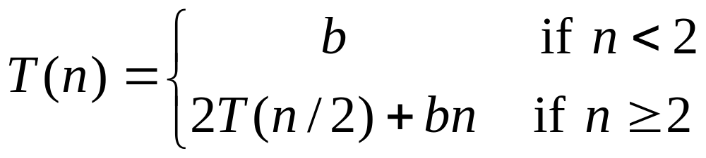
Recurrence Equation Analysis
The conquer step of merge-sort consists of merging two sorted sequences, each with n/2 elements and implemented by means of a doubly linked list, takes at most bn steps, for some constant b.
Likewise, the basis case (n < 2) will take at b most steps.
Therefore, if we let T(n) denote the running time of merge-sort:
We can therefore analyze the running time of merge-sort by finding a closed form solution to the above equation.
  That is, a solution that has T(n) only on the left-hand side.

Slide 48
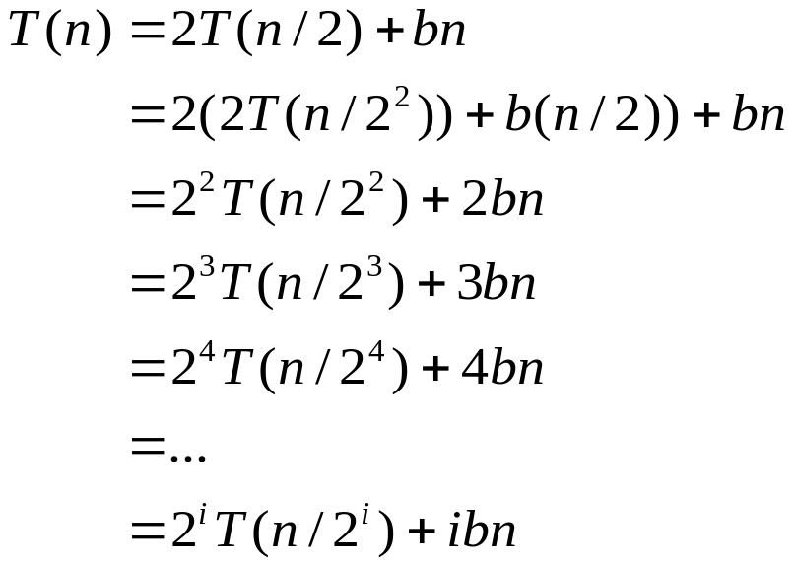

Iterative Substitution
In the iterative substitution, or “plug-and-chug,” technique, we iteratively apply the recurrence equation to itself and see if we can find a pattern:
Note that base, T(n)=b, case occurs when 2^{i}=n. That is, i = log n.
So,
Thus, T(n) is O(n log n).

Slide 49

The Recursion Tree
Draw the recursion tree for the recurrence relation and look for a pattern:
depth
T’s
size
time
0
1
n
bn
1
2
n/2
bn
i
2^{i}
n/2^{i}
bn
…
…
…
…
Total time = bn + bn log n
(last level plus all previous levels)‏

Slide 50

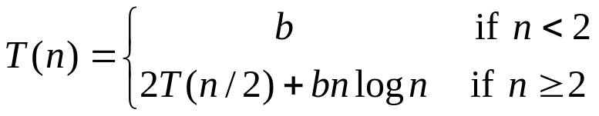
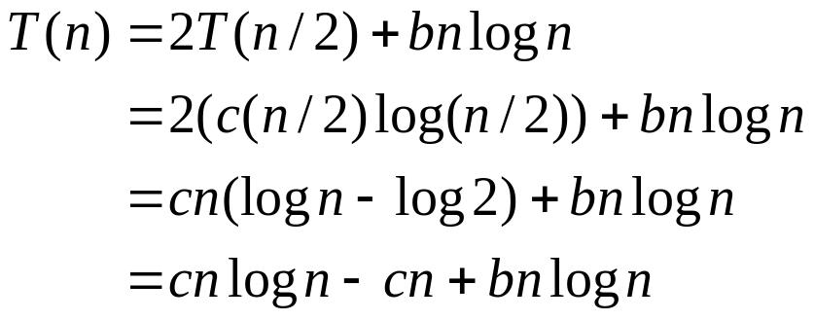
Guess-and-Test Method
In the guess-and-test method, we guess a closed form solution and then try to prove it is true by induction:
Guess: T(n) < cn log n.
Wrong: we cannot make this last line be less than cn log n

Slide 51
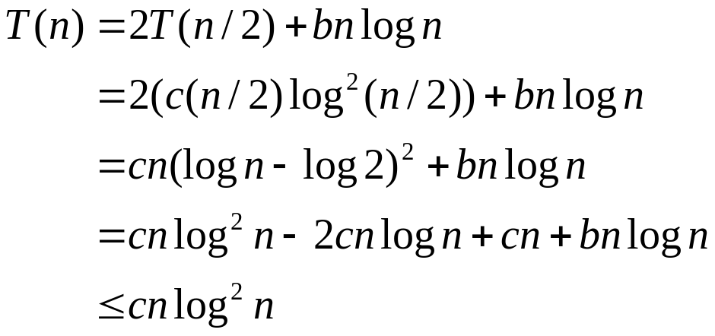
Guess-and-Test Method
Recall the recurrence equation:
Guess #2: T(n) < cn log² n.
  if c > b.
So, T(n) is O(n log² n).
In general, to use this method, you need to have a good guess and you need to be good at induction proofs.

Slide 52

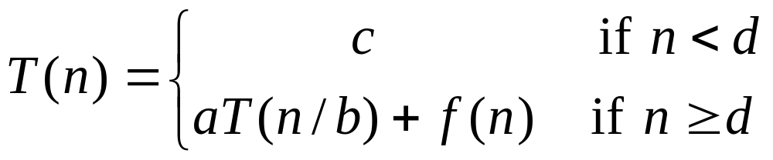
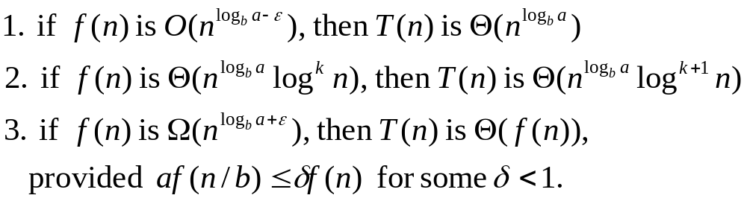
Master Method
Many divide-and-conquer recurrence equations have the form:
The Master Theorem:

Slide 53
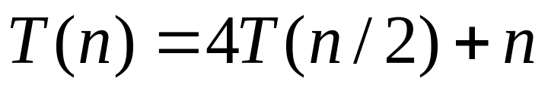
Master Method, Example 1
The form:
The Master Theorem:
Example:
Solution: log_{b}a=2, since f(n) = n =O(n ^{log}_{b}^{a - 1})‏
Here ∈=1 so case 1 says T(n) is = θ(n²).

Slide 54
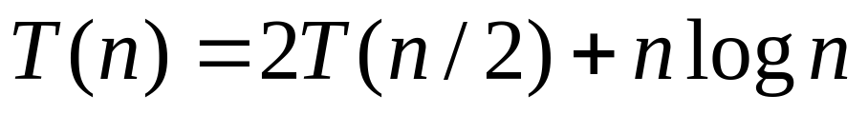
Master Method, Example 2
The form:
The Master Theorem:
Example:
Solution:
Here a =2 , b= 2 ,log_{b}a=1, f(n) = n log n , k = 1
F(n) = n log n = θ (n log n) so case 2 says T(n) is θ(n log² n).

Slide 55
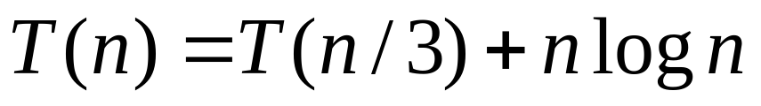
Master Method, Example 3
The form:
The Master Theorem:
Example:
Solution:
b= 3, a=1, log_{b}a = 0, f(n) = nlog n = Ω(n^{loga +1})‏
so case 3 says T(n) is θ(n log n).

Slide 56
Regularity condition
a f(n/b) <= δf(n) for some δ <1
For this case
a =1 ,b = 3
1(n/3 log(n/3)) = (1/3)(nlog (n/3))
<= 1/3(n log n)= δ f(n)

Slide 57
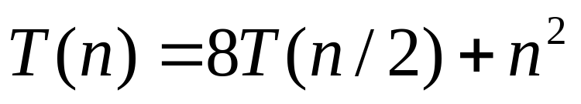
Master Method, Example 4
The form:
The Master Theorem:
Example:
Solution: b=2; a = 8 ; log_{b}a=3,
f(n) = n² =O(n³⁻¹); case 1 says T(n) is θ(n³).

Slide 58
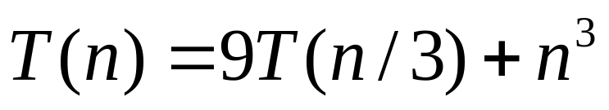
Master Method, Example 5
The form:
The Master Theorem:
Example:
Solution: log_{b}a=2, f(n) = n³ = Ω(n²⁺¹)‏
af(n/b)=9(n/3⁾³=n³/3 <= (1/3)f(n) so case 3 says T(n) is θ(n³).

Slide 59
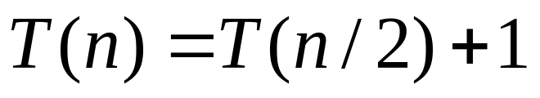
Master Method, Example 6
The form:
The Master Theorem:
Example:
(binary search)‏
Solution: log_{b}a=0, so case 2 says T(n) is O(log n).

Slide 60
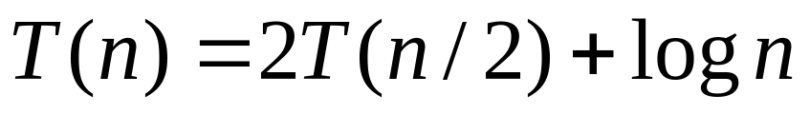
Master Method, Example 7
The form:
The Master Theorem:
Example:
(heap construction)‏
Solution: log_{b}a=1, so case 1 says T(n) is O(n).

Slide 61
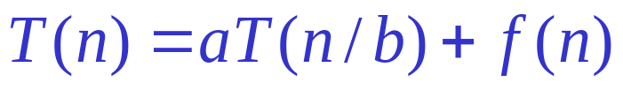
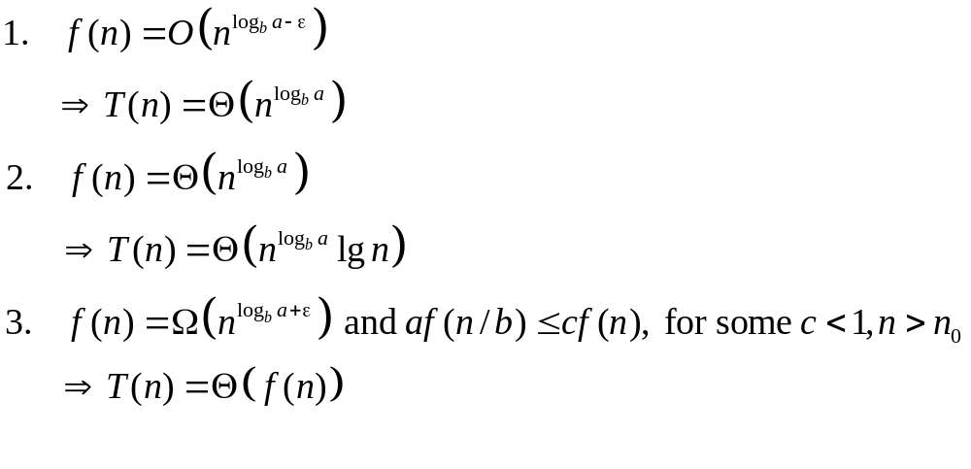
Master Theorem Summarized
Given a recurrence of the form
The master method cannot solve every recurrence of this form; there is a gap between cases 1 and 2, as well as cases 2 and 3

Slide 62
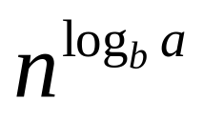
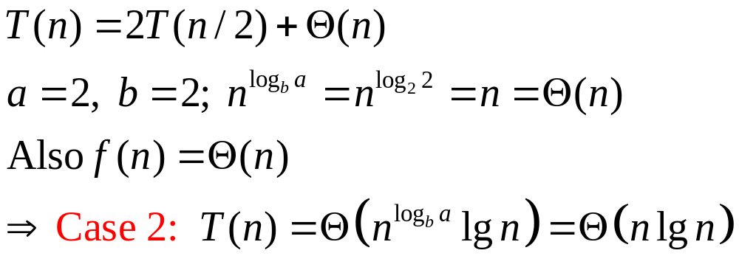
Strategy
Extract a, b, and f(n) from a given recurrence
Determine
Compare f(n) and asymptotically
Determine appropriate MT case, and apply
Example merge sort

Slide 63
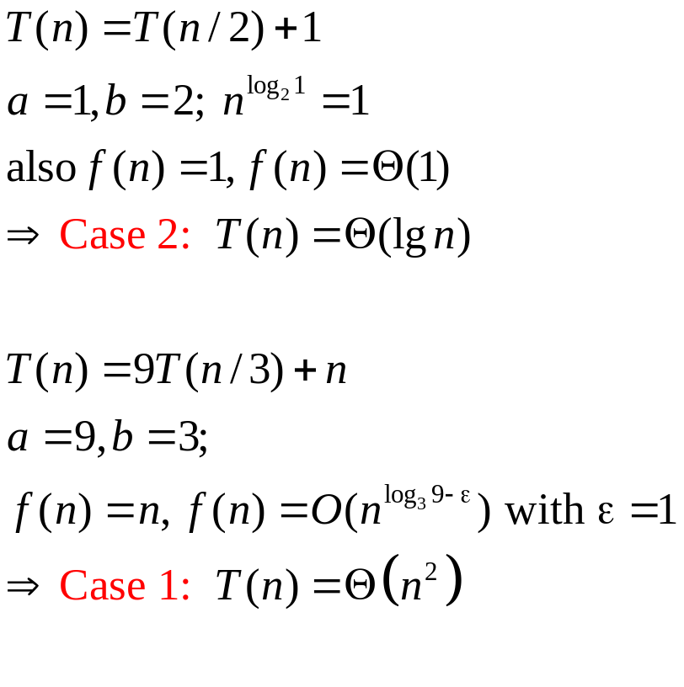
Examples
Binary-search(A, p, r, s):
q←(p+r)/2
if A[q]=s then return q
else if A[q]>s then
Binary-search(A, p, q-1, s)‏
else Binary-search(A, q+1, r, s)

Slide 64
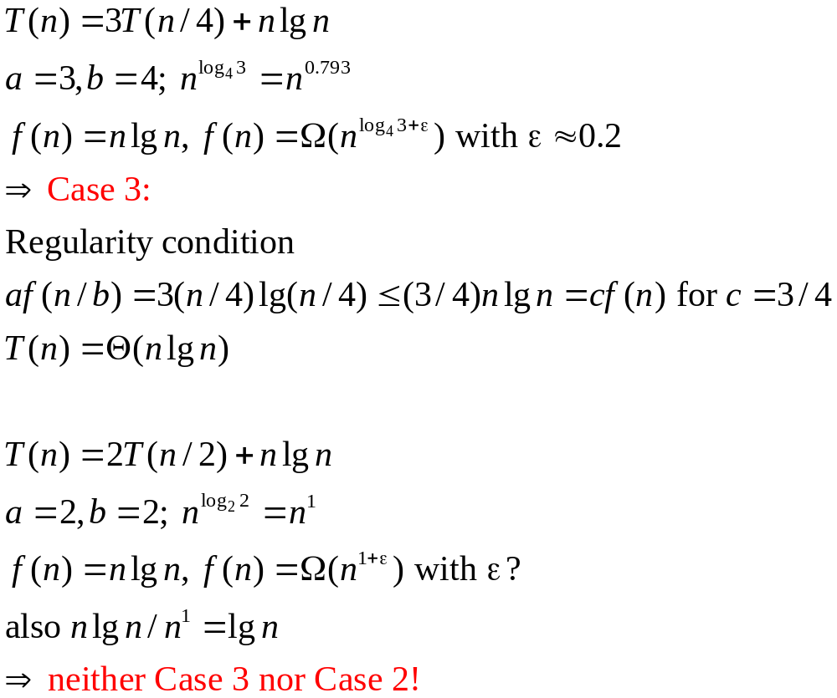
Examples (2)‏

Slide 65
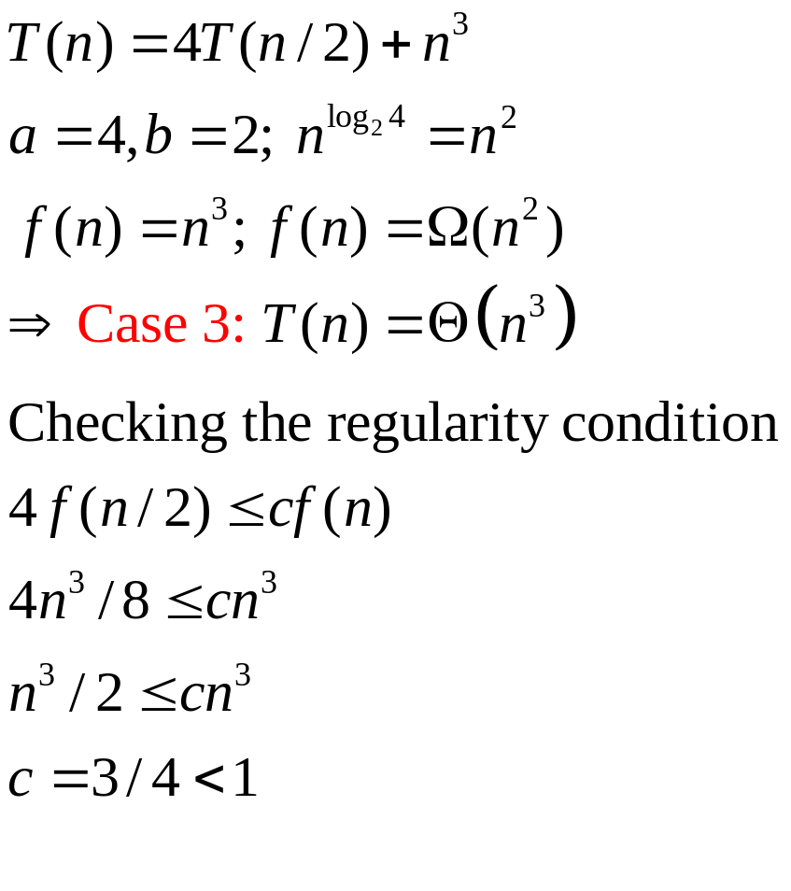
Examples (3)‏

Slide 66
Examples (3)‏

Slide 67
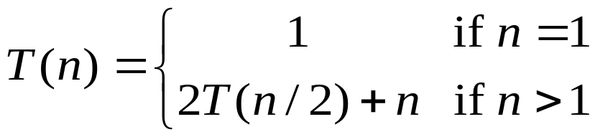

Repeated Substitution Method
Let’s find the running time of merge sort (let’s assume that n=2^{b}, for some b).

Slide 68
Iteration method(expansion method)‏
Substitution method
Master method

Slide 69
Iteration method
Idea is to expand(iterate) the recurrence and express it as a summation of terms depending only on n and the initial conditions.
Ex
T(n) = k + T(n/2) if n>1
      = c if n=1

Slide 70
T(n) = k + T(n/2)‏
T(n/2) = k + T(n/4)‏
T(n) = k + k+ T(n/4)‏
Repeating this process we get
T(n) = k + k + k + T(n/8)‏
And repeating over and over we get
T(n) = k + k+ … K + T(1)‏
= k + k+ … K + c
How many k’s are there? This is no. of times we can divide n by 2 to get down 1 that is log n.Thus
T(n) = (log n)*k + c where k and c are both constants
Thus
T(n) = O(log n)‏

Slide 71
Substitution
It involves guessing or informally recognizing the proper answer, then using proof by induction to prove it formally.
Example:
T(n) = k + T(n/2)‏
Based on some mysterious prompting from our subconscious, we might hypothesize that
T(n) = O(log n)‏

Slide 72
base T(1) = c constant(log 1)+c’
Inductive assumption: Assume that
T(I) <= cons*(log I) +c for all I <n
Now consider T(n) = k + T(n/2)‏
Since n/2 is less than n we can use assumption
T(n) <= k + cons *(log n/2 ) + c
i.e.

Slide 73
T(n) <= k + cons * (( log n) – 1) + c
< = k – cons + cons * (log n ) + c
Now what we need to show is that T(n) <= cons(log n) + c’
If we choose cons = k
T(n) <= cons * log(n) +c
Which is exactly what we wanted

Slide 74
Example
T(n) = 4 T(n/2) + n³
A = 4, b = 2 and f(n) = n³
Is n³ = Ω(n^{2+ ∈})?
Yes, for 0 < ∈ <1, so case 3 might apply.
Is 4(n/2)³ <= c.n³?
Yes , for c >= ½ so there exists a c <1 to satisfy the condition for regularity, so case 3 applies and T(n) = Θ (n³)‏

Slide 75


Slide 76

Ex

Slide 77

Suppose T(n) = aT(n/b) + cn^{k} for n>1 and n a power of b
T(1) = d
Where b >= 2 and k>=0 are integers a>0, c>0 d>= 0
Then

Slide 78
A tricky example
T(n) = 2*T(sqrt(n)) + log n
This can not be solved with the master theorem since sqrt(n) does not match the n/b pattern.
One way to simplify this problem is to replace n by another variable which is defined as a function of n
For example suppose let
M = log n
Or
N = 2**m

Slide 79
Thus
T(2**m) = 2*T(sqrt(2**m)) + m
        = 2*T(2**(m/2)) +m
        Now simplifying further by defining S(x) == T(2**x)‏
S(m) = 2*S(m/2) +m
So S(m) = O(m*log m)‏
T(2**m) = O(m* log m)‏
Or finally
T(n) =O((log n)*log(log n))‏

Slide 80
Tower of Hanoi
{// replace all the n plates from peg1 to peg3 using peg2
Hanoitower(peg1, peg3,peg2,n-1)‏
//replace first n-1 plate from peg1 to peg2 using peg 3
Hanoitower(peg1, peg2, peg3, 1)‏
Hanoitower(peg2, peg1, peg3, n-1)‏
}
M(n) = 2M(n-1) + 1
We can not use master theorem directly.
A trick called reparameterization can be used
As: m =b ^{n} for some fixed base b and exponential parameter m.
M(n) = M(log _{b} m) = M’(m) so
M’(m) = M(log _{b} m)‏
= M(n)‏

Slide 81
Tower of Hanoi
^{= 2M(n-1)+1}
^{=2M’(m/b)+1}
^{Now} we can use master theorem
As
a = 2 ; f(n) = n ⁰
^{So}
M’(m) = θ⁽m^{( log} _{b} ²⁾)= θ(2 ** log _{b} m) =
θ (2**n)‏

Slide 82
Divide-and-Conquer
Matrix multiplication and Strassen’s algorithm

Slide 83

.Strassen’s matrix multiplication
Let A and B be two n by n matrices.
The product C = AB can be obtained as
C(i,j) =
For all i and j between 1 and n.
To compute C(i,j) we need n multiplications.As C has n*n elements we can say matrix multiplication algorithm is θ(n ³)‏

Slide 84
Matrix Multiplication
How many operations are needed to multiply two 2 by 2 matrices?
[
[
[
r
s
[
=
a
b
[
e
f
[
t
u
c
d
g
h

Slide 85
Traditional Approach
[
[
[
r
s
[
=
a
b
[
e
f
[
t
u
c
d
g
h
r = ae + bg
s = af + bh
t = ce + dg
u = cf + dh
8 multiplications and 4 additions

Slide 86
Extending to n by n matrices
[
[
[
R
S
[
A
[
[
=
B
E
F
T
U
C
D
G
H
Each letter represents an n/2 by n/2 matrix
We can use the breakdown to form a divide and conquer algorithm
R = AE + BG
S = AF + BH
T = CE + DG
U = CF + DH
8 multiplications of n/2 by n/2 matrices
T(n) = 8 T(n/2) + Θ(n²)‏
T(n) = Θ(n³)‏

Slide 87
Example
[
[
[
[
[
[
1 2 3 4
5 6 7 8
9 10 11 12
13 14 15 16
17 18 19 20
21 22 23 24
25 26 27 28
29 30 31 32
=
R = AE + BG
S = AF + BH
T = CE + DG
U = CF + DH
What are A, B, …, H?
What happens at this level of the D&C multiplication?

Slide 88
Strassen’s Approach
[
[
[
r
s
[
=
a
b
[
e
f
[
t
u
c
d
g
h
p1 = a(f – h)‏
p2 = (a+b)h
p3 = (c+d)e
p4 = d(g-e)‏
p5 = (a+d)(e + h)‏
p6 = (b-d)(g+h)‏
p7 = (a-c)(e+f)‏
r = p5 + p4 - p2 + p6
s = p1 + p2
t = p3 + p4
u = p5 + p1 – p3 – p7
7 multiplications
18 additions

Slide 89
Extending to n by n matrices
[
[
[
R
S
[
A
[
[
=
B
E
F
T
U
C
D
G
H
Each letter represents an n/2 by n/2 matrix
We can use the breakdown to form a divide and conquer algorithm
7 multiplications of n/2 by n/2 matrices
18 additions of n/2 by n/2 matrices
T(n) = 7 T(n/2) + Θ(n²)‏
T(n) = Θ(n^{lg 7})‏

Slide 90
Example
[
[
[
[
[
[
1 2 3 4
5 6 7 8
9 10 11 12
13 14 15 16
17 18 19 20
21 22 23 24
25 26 27 28
29 30 31 32
=
p1 = a(f – h)‏
p2 = (a+b)h
p3 = (c+d)e
p4 = d(g-e)‏
p5 = (a+d)(e + h)‏
p6 = (b-d)(g+h)‏
p7 = (a-c)(e+f)‏
r = p5 + p4 - p2 + p6
s = p1 + p2
t = p3 + p4
u = p5 + p1 – p3 – p7
What are A, B, …, H?
What happens at this level of the D&C multiplication?

Slide 91
Observations
Comparison: n= 70
  Direct multiplication: 70³ = 343,000
  Strassen: 70^{lg 7} is approximately 150,000
  Crossover point typically around n = 20
Hopcroft and Kerr have shown 7 multiplications are necessary to multiply 2 by 2 matrices
  But we can do better with larger matrices

Slide 92
The problem of multiplying long integers
X,Y two n-bit integers.
Simple multiplication is O(n ²) algorithm counting single bit shifting or digit multiplication as one step.
X:
A B
X = A 2 ^{n/2} + B
Y = C 2 ^{n/2} + D
Y:
C D
XY = AC 2 ^{n} + (AD +BC )2 ^{n/2} +BD

Slide 93
Four multiplications of n/2 bit integers (AC,AD,BC and BD), three additions with at most 2n bits (corresponding to three + signs) and two shifts
(multiplications by 2 ^{n} and 2 ^{n/2}). As these additions and shifts take O(n) steps ,we can write recurrence relation for it as:
T(1) = 1
T(n) = 4 T(n/2) + cn
Solving it
T(n) is O(n ²)‏
Which is no improvement over ordinary method.

Slide 94
We can get asymptotic improvement if we decrease the number of sub problems.
XY = AC2 ^{n} +[( A+B)(D+C) - AC - BD]2 ^{n/2} + BD
It requires only three multiplications of n/2 bit integers AC , BD, and (A-B)(D-C) , six additions or subtractions and two shifts.
All operations except multiplications take O(n) steps
the time T(n) is given as:

Slide 95
T(1) = 1
T(n) = 3 T(n/2) + cn
Solution is T(n) O( n ^{log} ₂ ³ ) = O( n ^{1.59})‏

Slide 96
Example
23 X 14= 322
= (2x10¹ + 3x 10⁰)(1 x 10¹ +4 x 10^{0)‏}
= (2x1)10² + (3 x 1 + 2 x 4)10¹ +(3 x 4 ) 10⁰
= 322
But it uses the same 4 digit multiplications as the classic method.

Slide 97
= (2 x 1)10² + (3 x 1 + 2 x 4)10¹ +(3 x 4 ) 10⁰
(3 x 1 + 2 x 4) = (2 +3)x(1+4) – 2 x1 – 3 x 4

Slide 98
2101 x 1130
(21 x 11)10⁴ + [(21 +01)(11 +30)- 21x 11- 01 x 30]10² +01 x 30
21 x 11 = 2 x 1 x 10² +1 x 1 + [(2+1)(1+1)-2- 1]10⁰ = 231
01 x 30 = 0 x 3 x 10² + (1 x 3 – 0 – 0 )10 + 0
= 30
22 x 41 = 8x 10² + 2 x 10⁰ + [ 4x5 –8-2]10¹
800 +2 + 100 = 902
Hence answer =

Slide 99
Worst case
T(n) = P(n) + T( 0) + T( n-1)‏
= c.n + 0 + T(n-1)‏
= c.n + c.(n-1) + T(n-2)‏
= c.n + c.(n-1) + c.(n-2) + T(n-3)‏
.
.
= c (1+2+3+ n) + T(0)‏
= c.n.(n+1)/2
= O(n ²)

Slide 100
Quick Sort
Similar to Merge Sort but the partitioning of the array is not into halves, but by choosing a pivot point, with lesser numbers on left, greater on right.
Quick sort partitions the array of numbers to be sorted, but does not need to keep a temporary array.
Quick sort is faster than Merge sort because it does not go through the merge phase.

Slide 101
Quick Sort Approach
1
n
A
Pivot element
A
y ≤ x
x
y ≥ x
Sort recursively
Sort recursively

Slide 102
Complexity analysis for Quick sort
The best case occurs when the pivot partitions the set into halves. The complexity is then O(N log N).
The worst case occurs when the pivot is the smallest element. The complexity is then O(N²).
The average case is also O(N log N) because the problem is halved at each step.

Slide 103
Quick Sort Algorithm
Input: Unsorted sub-array A[p..r]
Output: Sorted sub-array A[p..r]
QUICKSORT (A, p, r)‏
if p < r
then q ← PARTITION(A, p, r)‏
QUICKSORT (A, p, q)‏
QUICKSORT (A, q+1, r)‏

Slide 104
Partition Algorithm
Input: Sub-array A[p..r]
Output: Sub-array A[p..r] where each element of A[p..q] is ≤ to each element of A[(q+1)..r]; returns the index q
PARTITION (A, p, r)‏
1 x ← A[p]
2 i ← p -1
3 j ← r +1
4 while TRUE
5 repeat j ← j - 1
6 until A[j] ≤ x
7 repeat i ← i + 1
8 until A[i] ≥ x
9 if i < j
10 then exchange A[i] ↔A[j]
11 else return j
Θ(n) where n = r-p+1

Slide 105
Picking a pivot
Choosing the first element in the array for pivot will give us O(N²) complexity if the array is sorted.
Choosing the middle point is safe; it will give average complexity, but does not necessarily give the fastest running time.
The median would give us the best running time but it is time-consuming to compute the median.
We approximate the median by taking the median of 3 numbers in the array, namely the first, the middle and the last elements.

Slide 106
Quick Sort
Each time the function recurses, a "key" value of the structure is selected to be positioned.
Values less than the key are passed to the left side of the structure and values that are greater than the key are passed to the right side of the structure.
These "left to right" and "right to left" scans and swaps continue until a flag condition tells them to stop.
The function then repeatedly scans through the structure from two directions.

Slide 107
This occurs when the structure can be divided into two sorted partitions.
The key is then "switched into its final position".
Next the quick sort function is called to sort the partition that contains the values that are less than the key.
Then the quick sort function is called to sort the partition that contains the values that are greater than the key.
The above algorithm continues until a condition indicates that the structure is sorted.

Slide 108
Quick Sort
A Step Through Example
This is the initial array that you are starting the sort with
The array is pivoted about its first element p =3
Find first element larger than pivot (underlined) and the last element not larger than pivot (italicised)‏

Slide 109
Quick Sort
A Step Through Example
Swap those elements
Scan again in both directions
Swap

Slide 110
Quick Sort
A Step Through Example
Scan
The pointers have crossed: swap pivot with italicised.
Pivoting is now complete. Recursively sort subarrays on each side of pivot.
The array is now sorted.

Slide 111

Quick Sort

Slide 112
Treatment of elements equal to pivot
If we ignore elements equal to pivot, then i & j do not stop. This creates wildly uneven subsets in the recursion, & can lead to a complexity of O(N²).
If i & j both stop at elements equal to the pivot, & if the array is made up of all duplicates, then everyone swaps. In this case all subsets in the recursion are even & the complexity is O(N log N).

Slide 113
Analysis of Quick Sort
Worst-case: if unbalanced partitioning
  One region with 1 element and the other with n-1 elements
  If this happens in every step ⇒ Θ(n²)‏
  T(n) = T(n-1) + T(1) + Θ(n) ⇒ Θ(n²)‏
n
1
n -1
1
n -2
1
n -3

Slide 114
Worst-case occurs
  When array is already sorted (increasingly)‏
Best-case: if balanced partitioning
  Two regions, each with n/2 elements
  T(n) = 2T(n/2) + Θ(n) ⇒ Θ(n lg n)‏
Average case closer to the best case than the worst case

Slide 115
The selection problem:
Input: A set A of n distinct numbers and a number i , with
1 ≤ i ≤ n.
Output: The element x ∈ A that is larger than exactly i − 1 other elements in A.
In other words, the ith smallest element of A.
The selection problem can be solved in O(n lg n) time.
• Sort the numbers using an O(n lg n)-time algorithm, such as heapsort or mergesort.
• Then return the ith element in the sorted array.
There are faster algorithms, however

Slide 116
First, we’ll look at the problem of selecting the minimum and maximum of a
set of elements
Finally, we’ll look at a more complicated general selection algorithm with a
time bound of O(n) in the worst case

Slide 117
Minimum and maximum
We can easily obtain an upper bound of n−1 comparisons for finding the minimum of a set of n elements.
• Examine each element in turn and keep track of the smallest one.
• This is the best we can do, because each element, except the minimum, must be compared to a smaller element at least once
The following pseudocode finds the minimum element in array A[1 . . n]:
MINIMUM(A, n)‏
min ← A[1]
for i ← 2 to n
do if min > A[i ]
then min← A[i ]
return min
The maximum can be found in exactly the same way by
replacing the > with < in the above algorithm

Slide 118
Simultaneous minimum and maximum
Some applications need both the minimum and maximum of a set of elements.
• For example, a graphics program may need to scale a set of (x, y) data to fit
onto a rectangular display. To do so, the program must first find the minimum
and maximum of each coordinate.
A simple algorithm to find the minimum and maximum is to find each one independently.
There will be n − 1 comparisons for the minimum and n − 1 comparisons
for the maximum, for a total of 2n −2 comparisons. This will result in _(n) time.
In fact, at most 3⎣n/2⎦comparisons are needed to find both the minimum and
maximum:

Slide 119
• Maintain the minimum and maximum of elements seen so far.
• Don’t compare each element to the minimum and maximum separately.
• Process elements in pairs.
• Compare the elements of a pair to each other.
• Then compare the larger element to the maximum so far, and compare the smaller element to the minimum so far.
This leads to only 3 comparisons for every 2 elements.
• If n is even, compare the first two elements and assign the larger to max and the smaller to min. Then process the rest of the elements in pairs.
• If n is odd, set both min and max to the first element. Then process the rest of the elements in pairs

Slide 120
Analysis
If n is odd, we perform 3⎣ n/2 ⎦ comparisons. If n is even we perform 1 initial comparison followed by 3(n-2)/2 comparisons for a total of 3n/2-2.Thus in either case the total number of comparisons is at most 3 ⎣ n/2 ⎦

Slide 121
The selection problem
Selection in worst-case linear time
We can find the ith smallest element in O(n) time in the worst case.
We’ll describe
a procedure SELECT that does so.

Slide 122
SELECT recursively partitions the input array.
Idea: Guarantee a good split when the array is partitioned.
• Will use the deterministic procedure PARTITION, but with a small modification.
Instead of assuming that the last element of the sub array is the pivot, the modified PARTITION procedure is told which element to use as the pivot.
SELECT works on an array of n > 1 elements. It executes the following steps:

Slide 123


Slide 124
2. Find the median of each of the ⎣n/5⎦groups:
Run insertion sort on each group.
It Takes O(1) time per group since each group has ≤ 5 elements.
Then just pick the median from each group, in O(1) time.
3. Find the median x of the ⎣n/5⎦ medians by a recursive call to SELECT.
(If
⎣n/5⎦ is even, then follow our convention and find the lower median.)

Slide 125
4. Using the modified version of PARTITION that takes the pivot element as input, partition the input array around x. Let x be the k th element of the array after partitioning, so that there are k−1 elements on the low side of the partition and n − k elements on the high side.
5. Now there are three possibilities:
• If i = k, just return x.
• If i < k, return the ith smallest element on the low side of the partition by making a recursive call to SELECT.
• If i > k, return the (i −k)th smallest element on the high side of the partition by making a recursive call to SELECT.

Slide 126
Analysis
Start by getting a lower bound on the number of elements that are greater than the
partitioning element x:
Each group is a column. Each white circle is the median of a
group, as found in step 2. Arrows go from larger elements to
smaller elements, based on what we know after step 2
Elements in the region on the lower right are known to be greater than x

Slide 127


Slide 128


Slide 129


Slide 130


Slide 131


Slide 132


Slide 133


Slide 134


Slide 135


Slide 136

Example
By this tree we can guess that T(n) is Θ(n²)‏

Slide 137
First, we prove the T (n) = Ω(n²) part by induction. The inductive hypothesis
is T (n) ≥ cn² for some constant c > 0.
T (n) = T (n − 1) + n
≥ c(n − 1)² + n
= cn² − 2cn + c + n
≥ cn²
if −2cn + n + c ≥ 0 or, equivalently, n(1 − 2c) + c ≥ 0. This condition holds
when n ≥ 0 and 0 < c ≤ 1/2.
For the upper bound, T (n) = O(n²), we use the inductive hypothesis that
T (n) ≤ cn² for some constant c > 0. By a similar derivation, we get that

Slide 138
T (n) ≤ cn² if −2cn + n + c ≤ 0 or, equivalently, n(1 − 2c) + c ≤ 0. This
condition holds for c = 1 and n ≥ 1.
Thus, T (n) = Ω (n²) and T (n) = O(n²), so we conclude that T (n) = Θ(n²).

Slide 139
Example
T (n) = T (√n) + 1
Let m = lg n and S(m) = T (2^{m}).
T (2^{m}) = T (2^{m/2}) + 1,
so
S(m) = S(m/2) + 1. Using the master theorem,
n^{logb} = n ^{log}₂ ¹ = n⁰ = 1
and f (n) = 1. Since 1 = Θ(1), case 2 applies and S(m) = Θ(lgm). Therefore,
T (n) = (lg lg n).

Slide 140
T (n) = 3T (n/2) + n lg n
We have f (n) = n lg n and n ^{log}_{b} ª = n ^{lg 3} ≈ n^{1.585}. Since n lg n = O(n ^{lg 3−ε})‏
for any 0 < ε ≤ 0.58, by case 1 of the master theorem, we have T (n) =
θ(n ^{lg 3}).

